Slide 1


Note to CFL SeattleCoach Facilitators, part 1 . . .
Whenever I have the chance to teach one of these:
I want to welcome people warmly and let them see my enthusiasm
I want to give them a clear overview of where we’re headed
I want to (briefly) tell the story of how and why coaching has become important to me + to leader effectiveness
I want to invite them to talk with me and each other about their experience of being coached: What worked?
I want to explain, illustrate, and apply the Core Four Play Card (“How”) Play Card—asking them to note a potential area of curiosity
Then I want to explain, illustrate, and apply the Explore-Experiment (“What”) Play Card, again asking them to note a potential area of curiosity
Then I want to explain, illustrate and apply the Coaching Leader’s Arena—asking them for a final time to note a potential area of curiosity
And finally, to choose an experiment and an accountability partner from the workshop
© Patricia Burgin, MA, https://www.seattlecoach.com/coaching-for-leaders.html
Notes:
This slides is a build.

Slide 2
Note to CFL SeattleCoach Facilitators, part 2 . . .
These are the best practices I like to include for maximum impact of this two-hour workshop:
Share the goals
Invite a key sponsor to introduce you and to endorse the workshop
Prepare and practice your personal “One Coach’s Story” (3-4 minutes)
In a pre-work email, ask participants to print hard copies of the three Play Cards
Ask table coaches to join you to help with breakout conversations
Do a demo after you introduce the first two Play Cards
Ask someone to be your coachee (in case no one volunteers)
Do a thorough overview of the Coaching Leader’s Arena, inviting members of the audience to find a next step
Make near the close sure you help people to identify both a next step and an accountability partner
Follow up within a day or two with additional coaching and training opportunities
© Patricia Burgin, MA, https://www.seattlecoach.com/coaching-for-leaders.html
Notes:
The leader/sponsor whom you’ll interview

Slide 3
Welcome to the Coaching for Leaders Launch Workshop
© Patricia Burgin, MA, https://www.seattlecoach.com/coaching-for-leaders.html

Slide 4
Where we’re headed
© Patricia Burgin, MA, https://www.seattlecoach.com/coaching-for-leaders.html

Slide 5
What does _________ think?
© Patricia Burgin, MA, https://www.seattlecoach.com/coaching-for-leaders.html
Notes:
The leader/sponsor

Slide 6
One Coach’s Story
© Patricia Burgin, MA, https://www.seattlecoach.com/coaching-for-leaders.html
Notes:
Your TED-ish talk

Slide 7
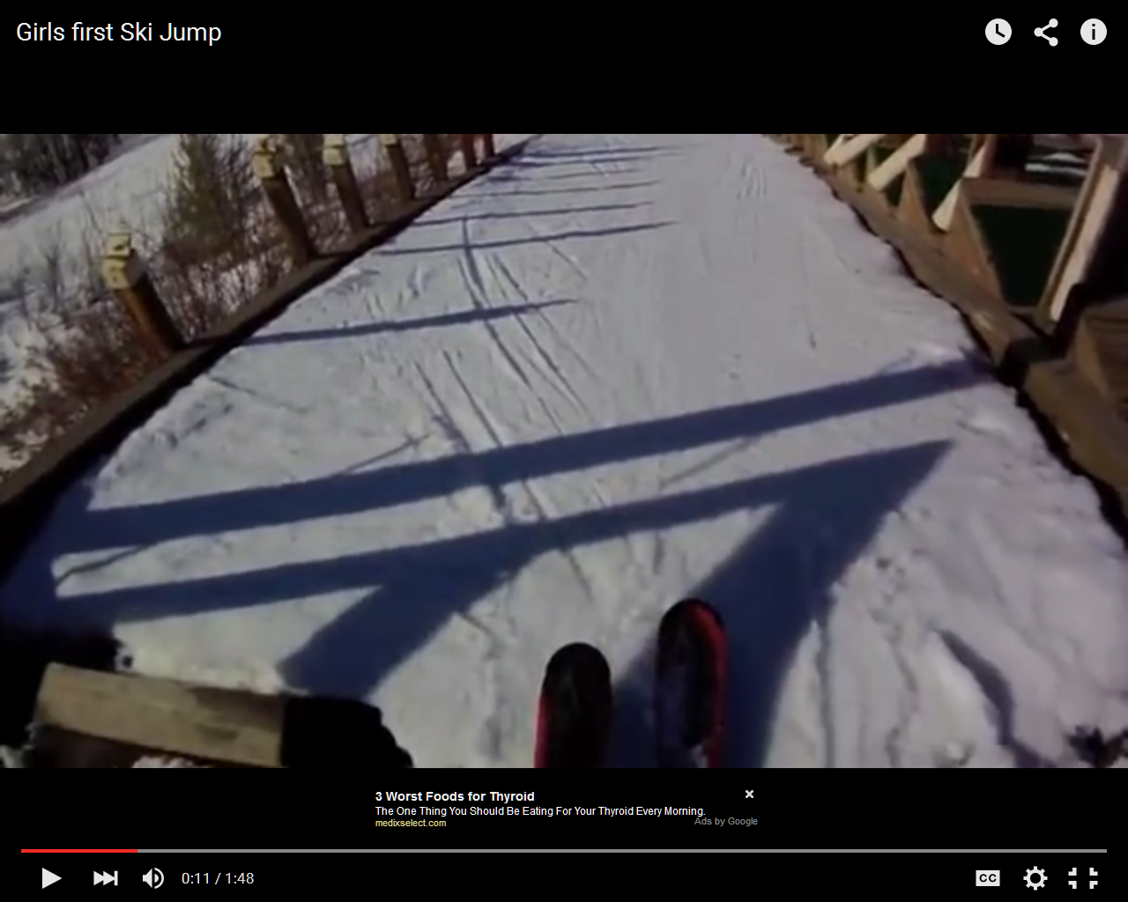
© Patricia Burgin, MA, https://www.seattlecoach.com/coaching-for-leaders.html

Slide 8
What do you notice in the skier’s process towards “safe enough”?
What do you hear in the energy of the coach in the background?
© Patricia Burgin, MA, https://www.seattlecoach.com/coaching-for-leaders.html
Notes:
This slides is a build.

Slide 9
The two big potential coaching errors:
To overuse your tendency to challenge
To overuse your tendency to comfort and support
© Patricia Burgin, MA, https://www.seattlecoach.com/coaching-for-leaders.html
Notes:
This slides is a build.

Slide 10
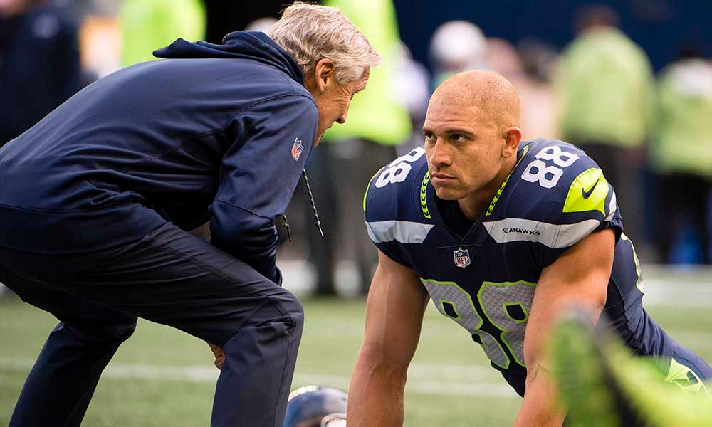
What’s going on here?
You probably just made up a story: Teaching? Telling? Challenging? Nagging? Rescuing? Propping up? Comforting/encouraging? Something else?
© Patricia Burgin, MA, https://www.seattlecoach.com/coaching-for-leaders.html

Slide 11
By triads for a few minutes . . .
In your experience of being coached growing up
(in sports, musically, by a parent or relative . . . )
Each person tell a sixty-second story
Everyone else listens for what seems important
What was it about your relationship with your “coach” that worked for you? It might have been in a single, memorable conversation.
How did feedback work in the relationship?
© Patricia Burgin, MA, https://www.seattlecoach.com/coaching-for-leaders.html
Notes:
Then, back together to share key words.

Slide 12
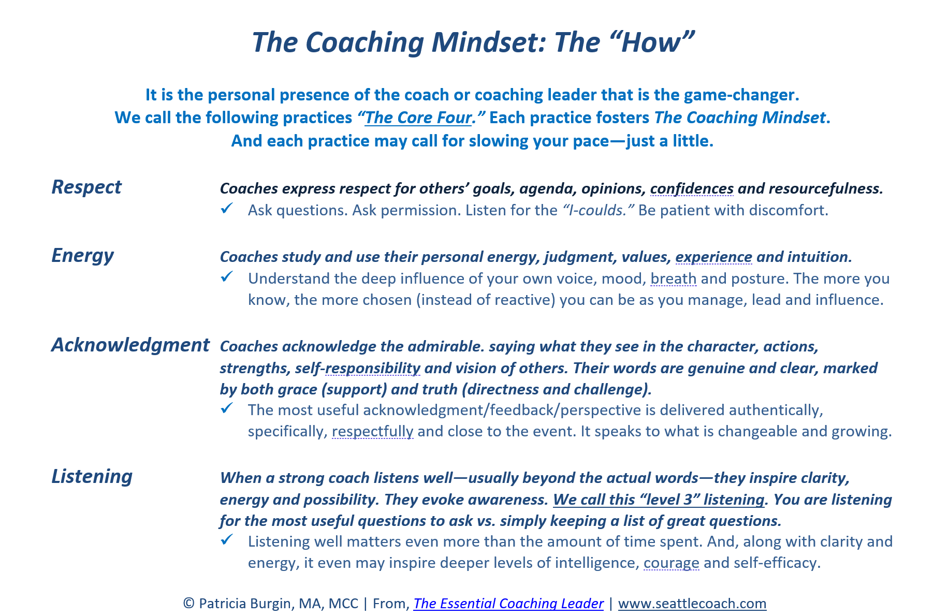

Notes:
Ask them to pull out their hard copies or to flip to p.13 in the Playbook

Slide 13
A 5-10 Minute Break
© Patricia Burgin, MA, https://www.seattlecoach.com/coaching-for-leaders.html

Slide 14
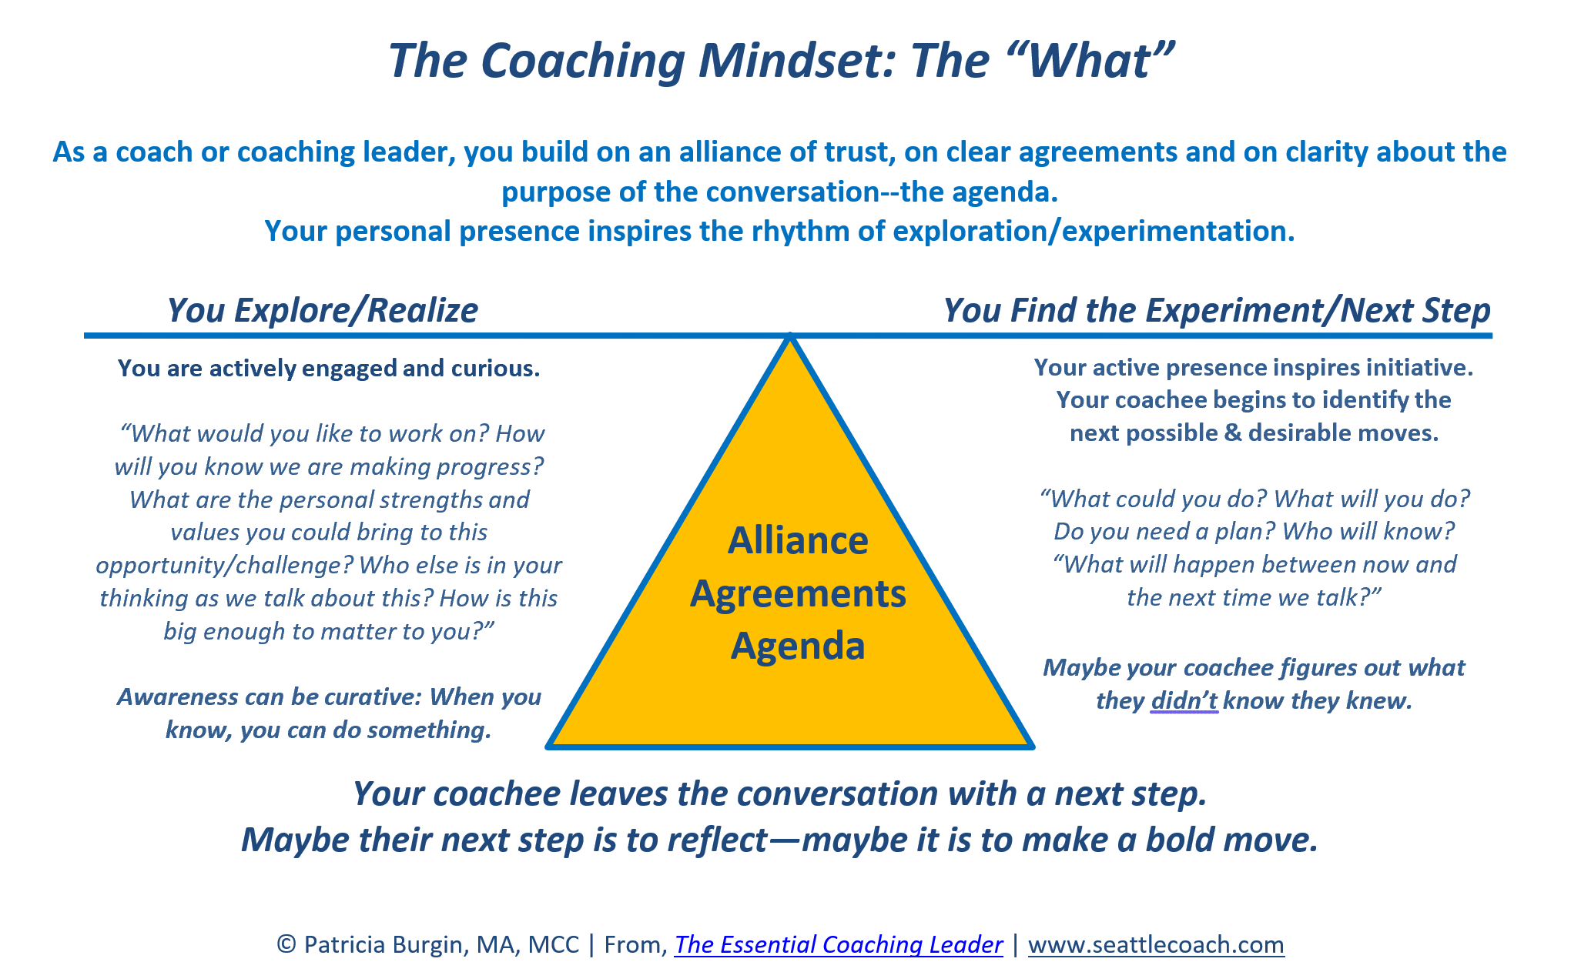
Notes:
Ask them to pull out their hard copies

Slide 15
The Coaching Leader’s Arena
You engage with your subject matter expertise and experience
© Patricia Burgin, from The Essential Coaching Leader
Notes:
Where coaching fits. The stuff for which Microsoft hired you

Slide 16
The Coaching Leader’s Arena
You, the coaching leader, get to be the main creator or doer
Your brain lights up
You engage with your subject matter expertise and experience
© Patricia Burgin, from The Essential Coaching Leader

Slide 17
The Coaching Leader’s Arena
You engage with your curiosity, questions and listening—maybe beyond the words
You, the coaching leader, get to be the main creator or doer
Your brain lights up
You engage with your subject matter expertise and experience
© Patricia Burgin, from The Essential Coaching Leader

Slide 18
The Coaching Leader’s Arena
You engage with your curiosity, questions and listening—maybe beyond the words
Your coachee gets to be the main creator or doer
You challenge and support
Their brain lights up
You, the coaching leader, get to be the main creator or doer
Your brain lights up
You engage with your subject matter expertise and experience
© Patricia Burgin, from The Essential Coaching Leader

Slide 19
The Coaching Leader’s Arena
You engage with your curiosity, questions and listening—maybe beyond the words
Telling, Advising, and Giving Direction
Your coachee gets to be the main creator or doer
You challenge and support
Their brain lights up
You, the coaching leader, get to be the main creator or doer
Your brain lights up
You engage with your subject matter expertise and experience
© Patricia Burgin, from The Essential Coaching Leader

Slide 20
The Coaching Leader’s Arena
You engage with your curiosity, questions and listening—maybe beyond the words
Teaching, Speaking, and Inspiring
Telling, Advising, and Giving Direction
Your coachee gets to be the main creator or doer
You challenge and support
Their brain lights up
You, the coaching leader, get to be the main creator or doer
Your brain lights up
You engage with your subject matter expertise and experience
© Patricia Burgin, from The Essential Coaching Leader

Slide 21
The Coaching Leader’s Arena
You engage with your curiosity, questions and listening—maybe beyond the words
Teaching, Speaking, and Inspiring
Telling, Advising, and Giving Direction
Mentoring, Sponsoring, and Introducing
Your coachee gets to be the main creator or doer
You challenge and support
Their brain lights up
You, the coaching leader, get to be the main creator or doer
Your brain lights up
You engage with your subject matter expertise and experience
© Patricia Burgin, from The Essential Coaching Leader

Slide 22
The Coaching Leader’s Arena
You engage with your curiosity, questions and listening—maybe beyond the words
Teaching, Speaking, and Inspiring
Telling, Advising, and Giving Direction
Connected and Co-Creating: Coaching
Mentoring, Sponsoring, and Introducing
Your coachee gets to be the main creator or doer
You challenge and support
Their brain lights up
You, the coaching leader, get to be the main creator or doer
Your brain lights up
You engage with your subject matter expertise and experience
© Patricia Burgin, from The Essential Coaching Leader

Slide 23
The Coaching Leader’s Arena
You engage with your curiosity, questions and listening—maybe beyond the words
Teaching, Speaking, and Inspiring
Telling, Advising, and Giving Direction
Connected and Co-Creating: Coaching
Mentoring, Sponsoring, and Introducing
Your coachee gets to be the main creator or doer
You challenge and support
Their brain lights up
You, the coaching leader, get to be the main creator or doer
Your brain lights up
You engage with your subject matter expertise and experience
© Patricia Burgin, from The Essential Coaching Leader
Notes:
Calm. Clear. Connected. Compassionate. Courageous.

Slide 24
The Coaching Leader’s Arena
You engage with your curiosity, questions and listening—maybe beyond the words
Teaching, Speaking, and Inspiring
Telling, Advising, and Giving Direction
Connected and Co-Creating: Coaching
Mentoring, Sponsoring, and Introducing
Your coachee gets to be the main creator or doer
You challenge and support
Their brain lights up
You, the coaching leader, get to be the main creator or doer
Your brain lights up
You engage with your subject matter expertise and experience
© Patricia Burgin, from The Essential Coaching Leader
Notes:
Gallup: Employees are looking for a sense of purpose; a chance to be developed.

Slide 25
Next Steps?
Q. In light of what we’ve talked about so far, take one minute to record:
Which quadrant to you think tends to be your “default?”
What is something you’d like to experiment with or even get better at (a 10% shift) in the next two weeks?
© Patricia Burgin, MA, https://www.seattlecoach.com/coaching-for-leaders.html

Slide 26

Index fingers up
(Who will know about your experiment?)
© Patricia Burgin, MA, www.seattlecoach.com
Notes:
When we’re in-person, I ask participants to point to someone in the room. Virtually, I ask them to find their name under “participants” and then to “rename” themselves with the name of the person they will check in with in the coming week.

Slide 27

© Patricia Burgin, MA, https://www.seattlecoach.com/coaching-for-leaders.html

Slide 28


Next Steps:
Check in with that person you pointed to in the coming week.
Read this “brief book about a big deal” www.pattyonamazon.com
More info to come in the next day or two about coach training opportunities
© Patricia Burgin, MA, https://www.seattlecoach.com/coaching-for-leaders.html
Notes:
Under #3, tell them about the training we do inside of organizations, CFL https://www.seattlecoach.com/coaching-for-leaders.html, and the even more in-depth training we do with individual coaching leaders https://www.seattlecoach.com/coach-training.html. Let them know that in your follow-up email, you’ll send info about both.

Slide 29
The SeattleCoach Toast
“To journey without being changed is to be a nomad.
To change without journeying is to be a chameleon.
To journey and be transformed by the journey is to be a pilgrim.”
-Mark Nepo
© Patricia Burgin, MA, https://www.seattlecoach.com/coaching-for-leaders.html

Slide 30

To the Journey Then!!
To the Journey Then!!
© Patricia Burgin, MA, https://www.seattlecoach.com/coaching-for-leaders.html

