Slide 1
Appreciative Inquiry
The learned habit of asking questions that strengthen a system’s capacity to apprehend, anticipate, and heighten positive potential in a way that is grounded in affirmation and appreciation.

Slide 2


Slide 3
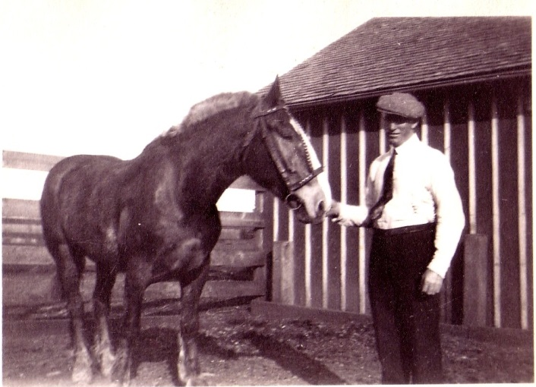
The world has changed. Human neurobiology, not so much.

Slide 4
MBTI Starting points / preferences:
ST Do you look first at facts, data, patterns?
SF Do you look first at the impact on the harmony and functioning of the team?
NT Do you look first at values, the big picture and potential outcomes?
NF Do you look first at building support, finding and engaging talent, colleagues, customers?

Slide 5
five questions for the four corners:
1. What does it actually look like/sound like when you are at your most effective with others?
2. What do you love to contribute to the team?
3. What kind of support from the team helps you to be your best?
4. How do you like to reflect, recover, and recharge your emotional battery?
Bonus question: Do you have any idea what makes you annoying to people in the other corners?

Slide 6
when your starting point isn’t working:
When your starting point isn’t working—even after you’ve doubled-down, what alternative strategy are you able to shift to? For example:
ST After you’ve examined the data and created order and predictability. Is it time to get more tolerant of a messy process?
Sf After you’ve helped the team to explore and deepen values and strengths, and been as kind and understanding as you can be. Is it time to compete and deliver?
nT After you’ve provided strong direction and clear outcomes. Is it time to slow your pace and listen?
nf After you’ve been winsome, engaging and persuasive. Is it time to get more firm and direct?

Slide 7
For thirty minutes, meet by teams. Each team member takes a few minutes to answer two questions:
  1. In light of the challenges and opportunities of the coming 30-60 days, what is something you want to get better at?
  2. What will that take? How can your team support you?

Slide 8
Read more about AI here: http://www.seattlecoach.com/the-gdi-team.html

