Slide 1
If your coaching skills as HR Pros and BPs got significantly better in the coming months, what would be different six months from now?

Slide 3
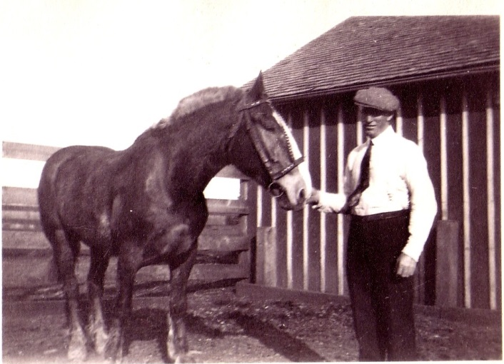
The world has changed. Human neurobiology, not so much.

Slide 4
Take a full minute to think of an idea about which you are really enthusiastic.
  An initiative at Microsoft
  A great weekend away with someone you love to be with
  A vacation or adventure you’re planning
Take note of several specifics that really matter to you.

Slide 5
In groups of three, identify three roles:
Presenters: Your job is to present an idea about which you are very enthusiastic (a weekend away, a vacation or adventure you’re planning). Begin by sharing the details of your idea. Be thoughtful, detailed, enthusiastic, compassionate. Continue presenting for about three minutes while your partner/friend/colleague responds based on the card handed to him/her.
Responders: You are the Presenter’s partner/friend/colleague. Your job is to respond to the Presenter by following the instruction cards that are handed to you by the Dealer.
Dealers: Your job it to quietly select instruction cards and hand them to the Responder every 45-60 seconds, making sure the Presenter does not see the cards.
You’ve got five minutes.

Slide 6
Debriefing Questions:
What happened viscerally?
What thoughts and judgments did you have?
What else did you notice?

Slide 8
Take a full minute and recapture your idea from earlier—in your heart, your head, your intuition. Recapture the specifics.
In groups of three, again, assign three roles:
Presenters: Your job is to present an idea about which you are very enthusiastic (a weekend away, a vacation or adventure you’re planning). Begin by sharing the details of your idea. Be thoughtful, detailed, enthusiastic, compassionate. Continue presenting for about three minutes while your partner/friend/colleague responds based on the card handed to him/her.
Responders: You are the Presenter’s partner/friend/colleague. Your job is to listen and respond to the Presenter by being the best coach you can be (based on what you know so far). Try to practice “The Core Four”. The Dealer will use his/her own coaching intelligence to hand you idea-cards. Do what’s on each card.
Dealers: Your job it to quietly select idea cards and hand them to the Responder in a way that you think will build their alliance with the Presenter. It doesn’t have to be a rapidly as before. Again, make sure the Presenter does not see the cards.
You’ve got ten minutes.

Slide 9
Debriefing Questions for Presenters:
What happened viscerally this time?
What thoughts and judgments about your Responder did you have?
What else did you notice?
Debriefing Questions for Dealers:
What did you notice as you watched the interaction? What did you want to see more of? Less of?
Debriefing Questions for Responders:
What did you try? What did you learn?

Slide 10
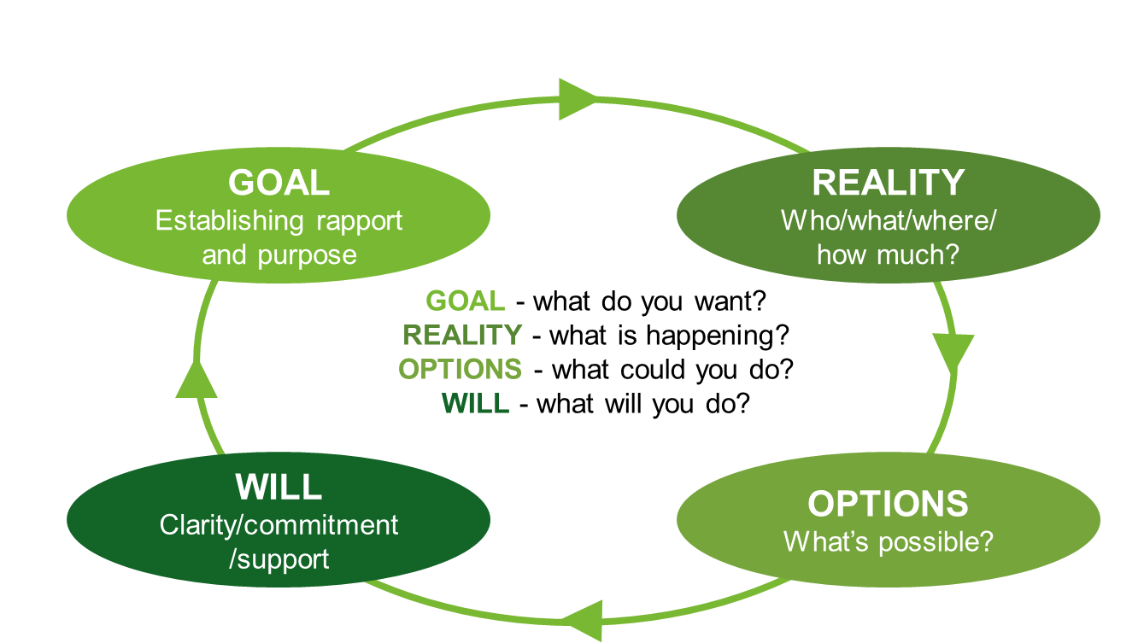
The GROW Model:
Finding and following the “Agenda”
Read more about the GROW model
Patricia Burgin, MA MCC. www.SeattleCoach.com. "Curiosity. Connection. Challenge."

Slide 12
Debriefing the Demo What did you notice about how we collaborated on our alliance and our agreement? How did we find the agenda? How did I explore reality? What happened when we talked about options/obstacles? Did we find/create a What next? Where did you see the Core Four?

Slide 13
By Pairs with the play card: “What is a conversation that you need to make happen in the coming two weeks?” Explore and arrive at an action point. Goal? Reality? Options? Obstacles? What? Will You? Ten minutes each, have a beginning, a middle and an end that includes a next step.) Debrief for 5 minutes and swap roles. At the end of thirty minutes we’ll debrief all together.

Slide 14
Relationship Building / SF
Executing / NT
Achiever
Arranger
Belief
Consistency
Deliberative
Discipline
Focus
Responsibility
Restorative
Adaptability
Developer
Connectedness
Empathy
Harmony
Includer
Individualization
Positivity
Relator
Strategic Thinking / ST
Influencing-Impacting / NF
Analytical
Context
Futuristic
Ideation
Input
Intellection
Learner
Strategic
Activator
Command
Communication
Competition
Maximizer
Self-Assurance
Significance
Woo

Slide 15
Questions for the Corners: Listening to “your Way”:
What’s it like in your corner?
What are the communication/leadership advantages of your group’s default approach?
In light of the coach development we’ve talked about today, what comes naturally to you?
And in light of the coach development we’ve talked about today, what will be a stretch for you?

Slide 16
Ten minutes each:
“Clients” identify a personal growing edge: A skill, an opportunity, event or conversation between now and May 7 that you want to do really well. It’s got to be big enough to matter.
Coaches: Listen well, explore what’s possible and desirable.
What will your client do?
When will your client do it?
Does he/she need a plan? Who will know?
Write down the plan.
Debrief for a few minutes: What worked? Then switch.

Slide 17

You can find links to resources, a coaching bibliography and tools we’ve introduced today at:

